Slide 1
UTSA CS 4593: CS-CURE
Course-based Undergraduate Research Experience in CS
Amanda Fernandez, Ph.D
UTSA Department of Computer Science
Spring 2024

Slide 2
Week 4: Research Tools

Slide 3
UTSA CS-CURE
Week 4
Objectives:
Learn common tools for research in CS
Leverage tools to facilitate, organize, & guide your research
Deliverables:
Activity 3: Formulating Research Questions (in-class Thursday)
Quiz 1 (on Canvas)

Slide 4
Research Tools
Finding & leveraging effective resources
Tools for…
Writing professional research
Organization of references
We’ll explore some - you find what works for you!
Tools for data later in the semester!

Slide 5
Tools for Conducting Research

Slide 6
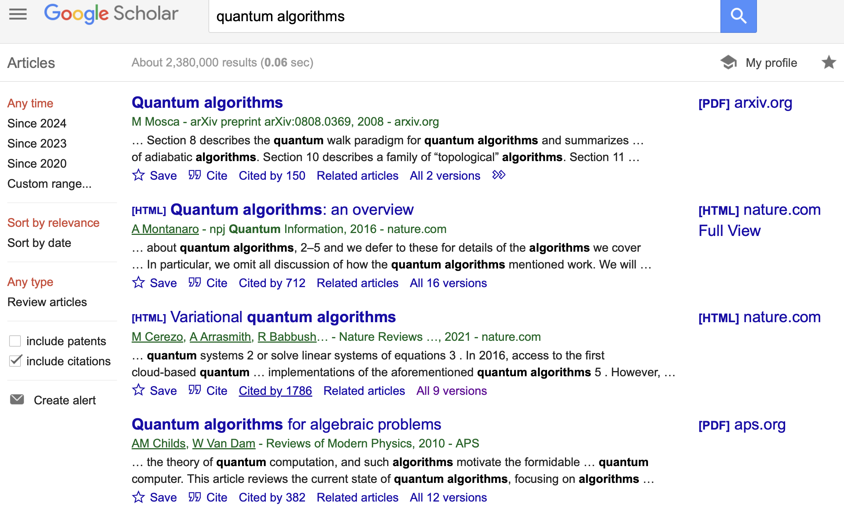
Google Scholar
Demo!
Read for free!
scholar.google.com
Find papers that have cited this one
Links to the author’s profile page
Find papers like this one

Slide 7

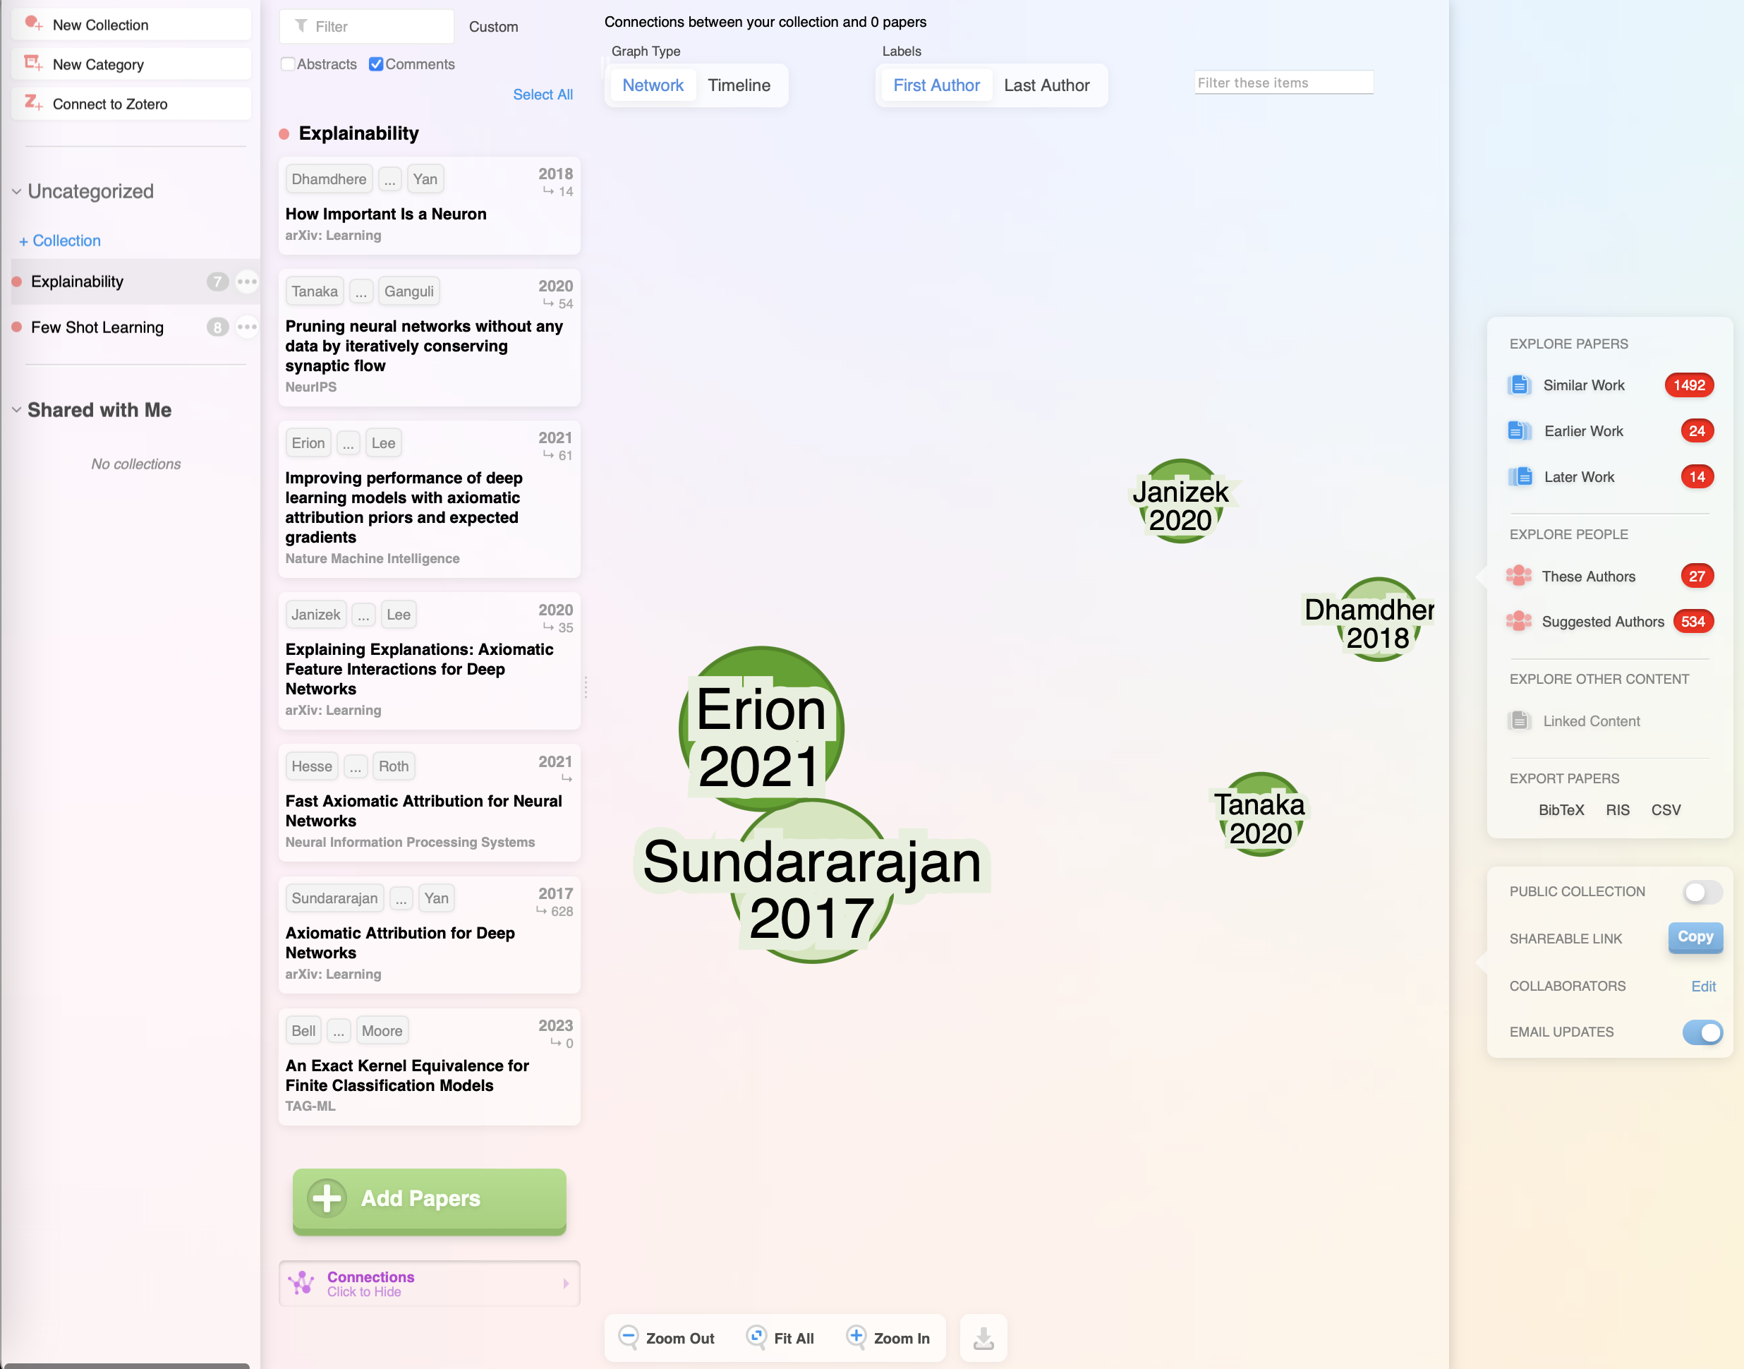
Research Rabbit
https://www.researchrabbit.ai/
Interactive graphical reference manager & search
Customize your own collections, share with collaborators, & integrate with tools.

Slide 8
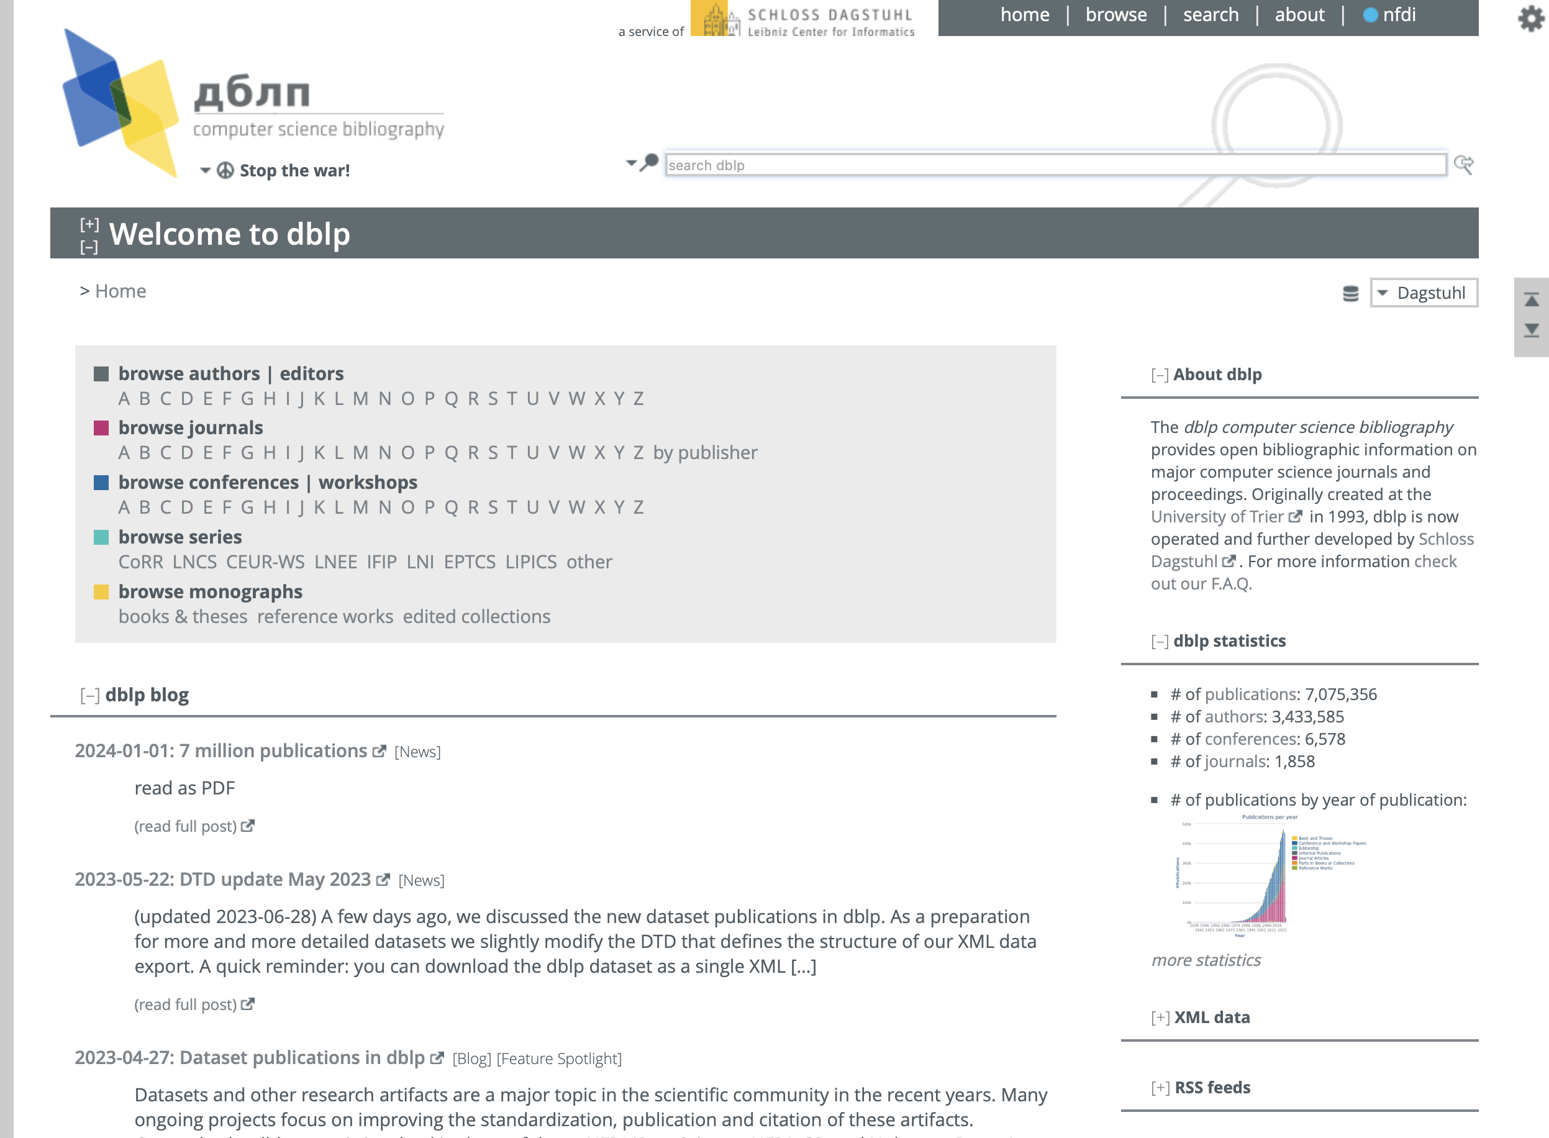
DBLP.org
Computer Science Bibliography
Resource for searching publications & scholars
Automatically indexed, focused on CS venues only

Slide 9

arXiv.org
“archive”
arXiv is a free distribution service and an open-access archive for nearly 2.4 million scholarly articles in the fields of physics, mathematics, computer science, quantitative biology, quantitative finance, statistics, electrical engineering and systems science, and economics.
Materials on this site are not peer-reviewed by arXiv.
IMPORTANT
If you find a reference on arXiv, look for the PUBLISHED work -
only that will have been peer reviewed.
(“Other versions” on Google Scholar, for example)

Slide 10
Writing & Presentations

Slide 11
LaTeX
“LAY-tek” or “LAH-tek”
Typesetting tool for professional-looking documents
Mark-up language more like HTML, but for docs - not “WYSIWIG”
\documentclass{article}
\begin{document}
First document. This is a simple example, with no extras.
\end{document}

Slide 12
Overleaf
Demo!
http://www.overleaf.com
In-browser LaTeX editor (+ doc sharing similar to Google Docs!)
Sign up for a free account.
Missed the in-class demo? Check out:
Documentation: https://www.overleaf.com/learn
“Learn LaTeX in 30 minutes: https://www.overleaf.com/learn/latex/Learn_LaTeX_in_30_minutes

Slide 13
Beamer
LaTeX class for presentations
https://www.overleaf.com/learn/latex/Beamer

Slide 14
Reference Managers

Slide 15
References in Professional Research
Importance
Citing existing work properly is key to..
Credibility & accuracy - supporting your claims
Transparency & reproducibility - allowing for others to build on your work
Professionalism & responsibility - meeting community requirements

Slide 16

References in Professional Research
Formatting
Different fields leverage different formats - e.g. APA, MLA, Chicago are common.
In CS, we leverage reference managers and each publication venue dictates the format.
You add the bibtex reference to a file.
The style sheet formats it for you!
Image source: bibliography.com

Slide 17
Bibtex
Demo in Overleaf
“bib-tex” or “bib-tek”
Tool for creating bibliographic databases & generating formatted references
Ensures accuracy and consistency of professional research!
Resources:
Bibtex Cheat Sheet: https://www.bibtex.com/e/article-entry/
Online Bibtex Editor: https://www.bibme.org/bibtex
Overleaf Bibtex Guide: https://www.overleaf.com/learn/latex/Bibliography_management_with_bibtex

Slide 18
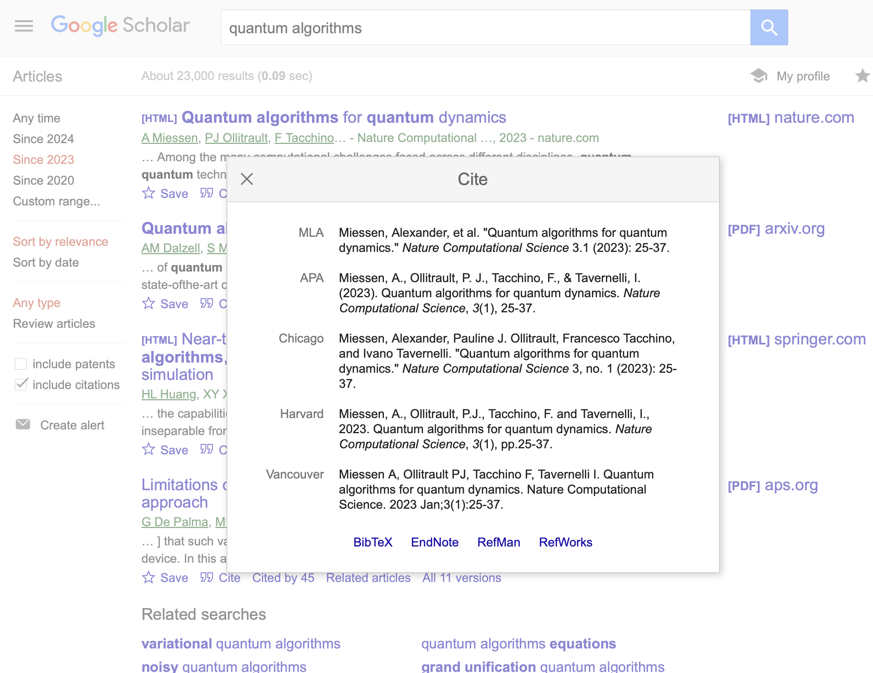

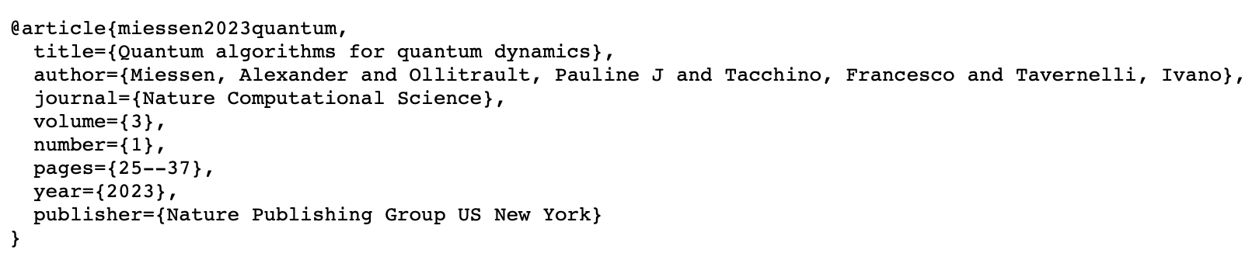
Bibtex
+ Google Scholar
Find a paper
Below it, click “Cite”
Copy the citation - for BibTex, this opens a new page.
Copy & paste the bib reference into the .bib file in your project.

Slide 19
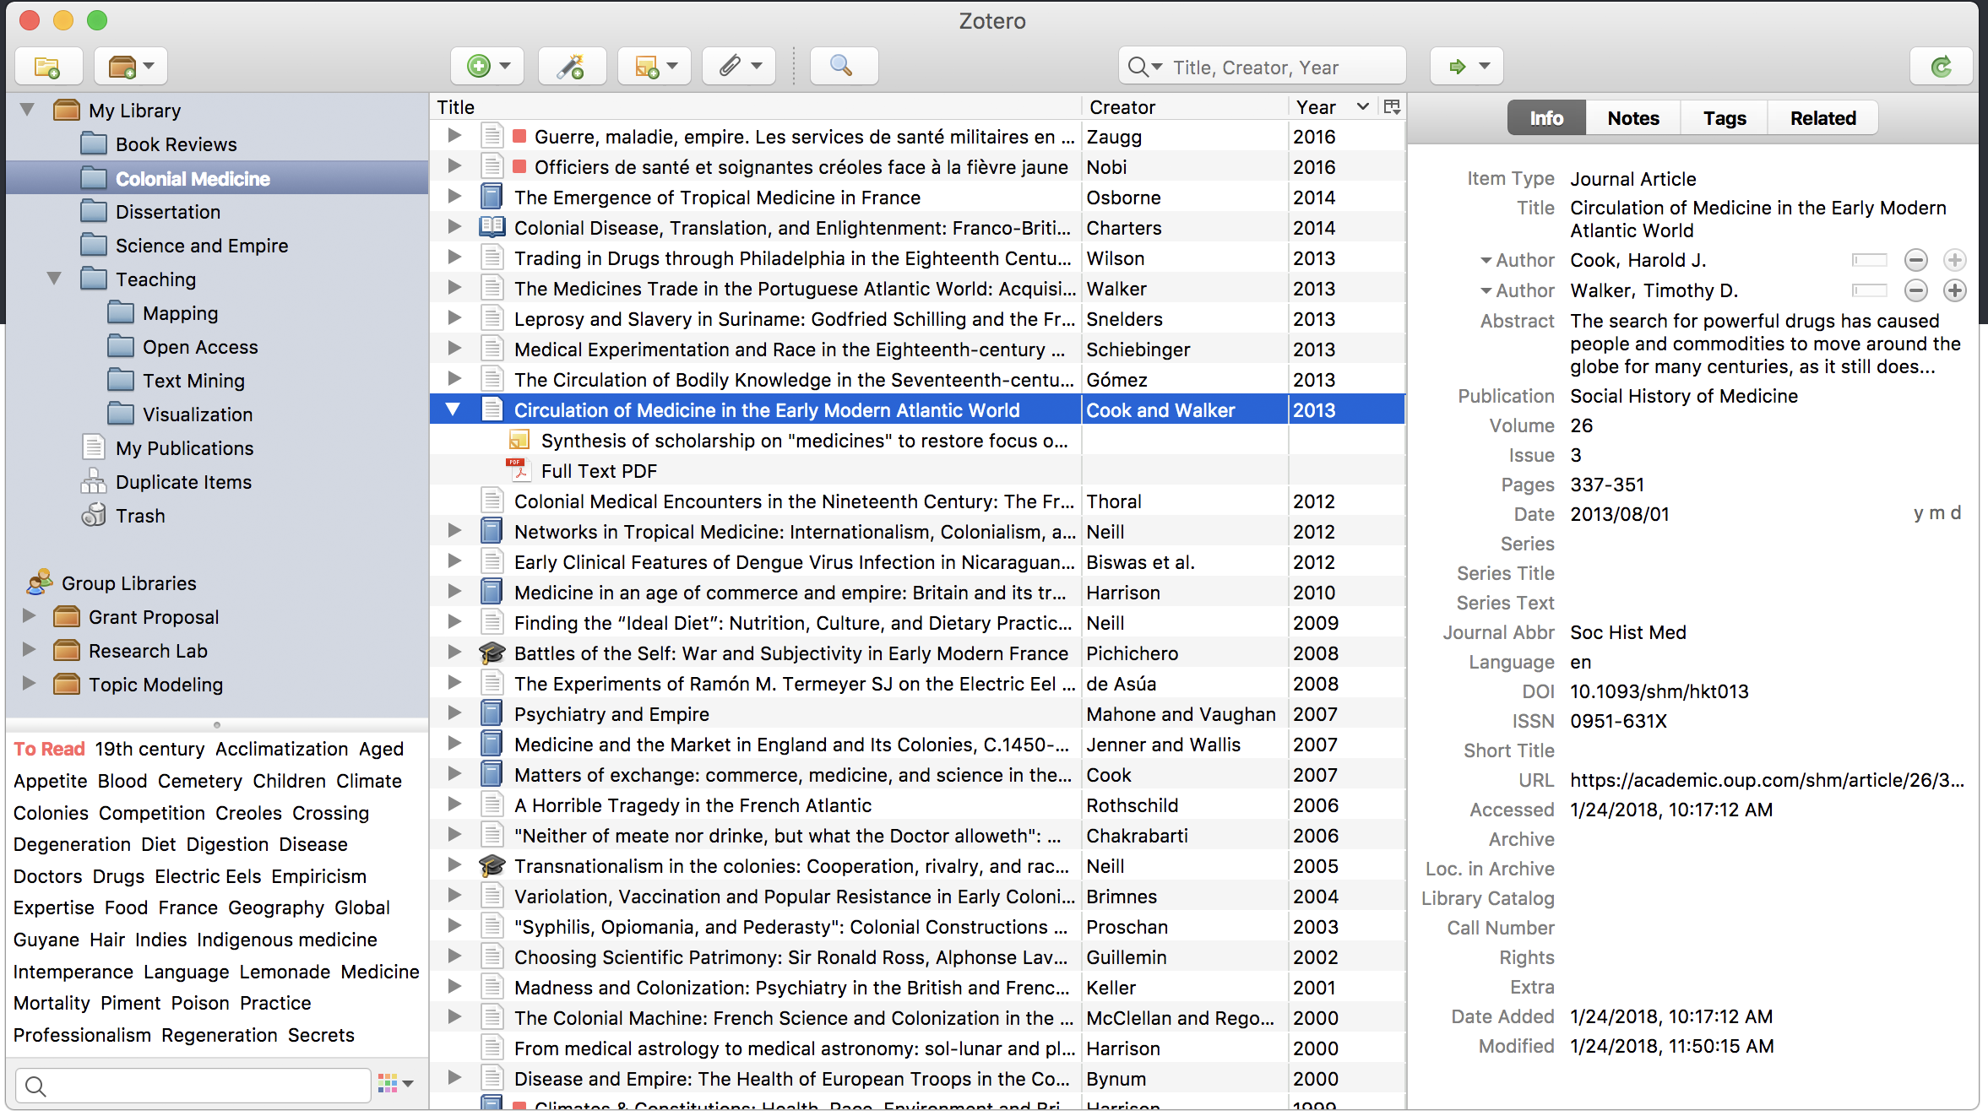
Zotero
https://www.overleaf.com/learn/how-to/How_to_link_your_Overleaf_account_to_Mendeley_and_Zotero
Reference management
Free desktop/mobile app
Free collaboration

Slide 20
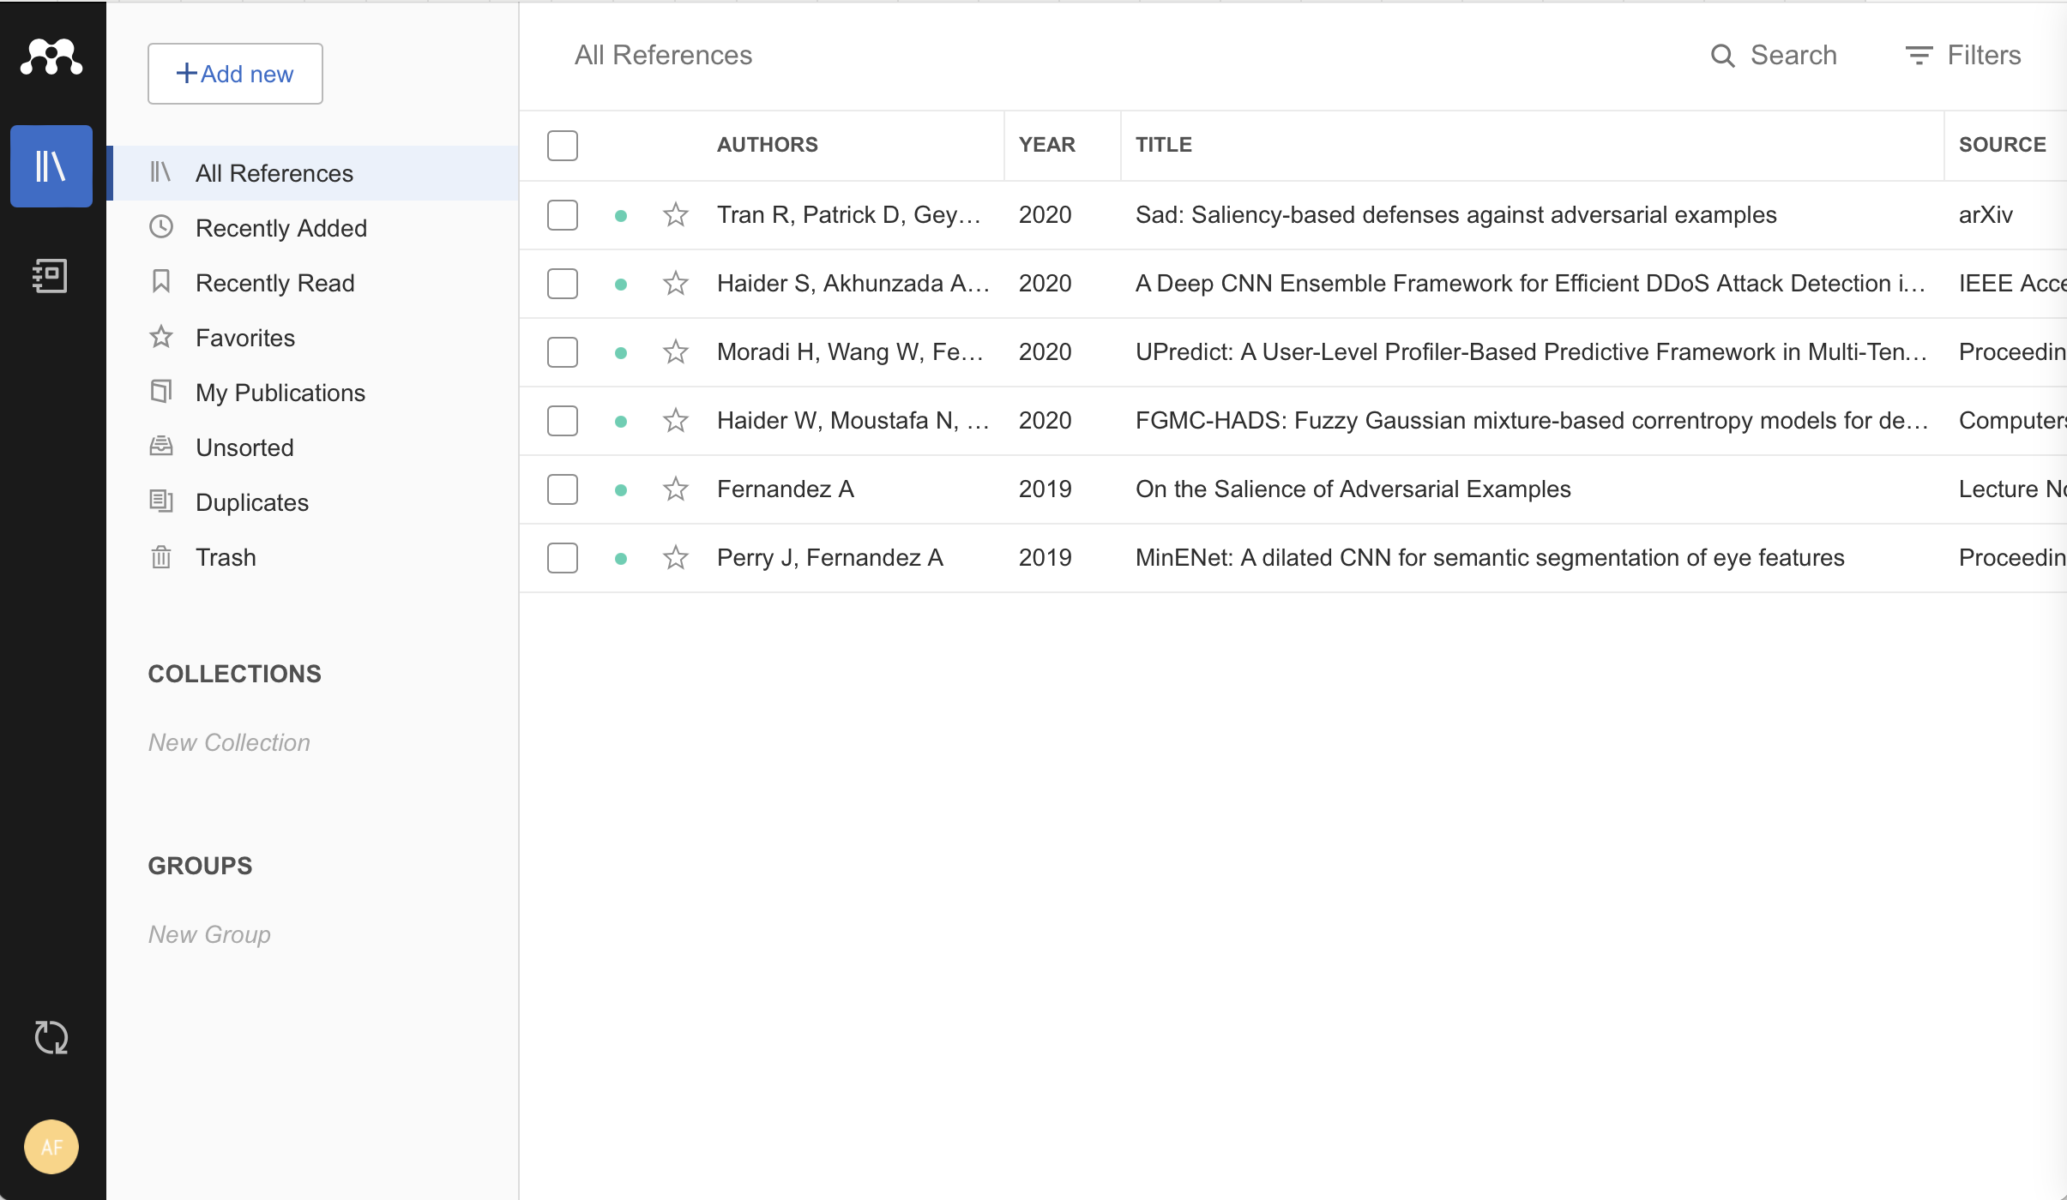
Mendeley
https://www.overleaf.com/learn/how-to/How_to_link_your_Overleaf_account_to_Mendeley_and_Zotero
Reference management
Free desktop/mobile app
Free collaboration
SSO with UTSA login

Slide 21
 | Mendeley | Zotero
Focus | Originally for managing PDFs & social aspects | Reference management & integration
Data storage | 2GB free | 300MB free
Availability | Desktop apps & web apps
Integration | MS Word, Google Docs, Overleaf | MS Word, Pages, Google Docs, Overleaf
Collaboration | Public & private groups | Free but limited
Additional Features | Note-taking & annotations within PDFs | Web capture for saving content from web pages

Slide 22
Research Project

Slide 23
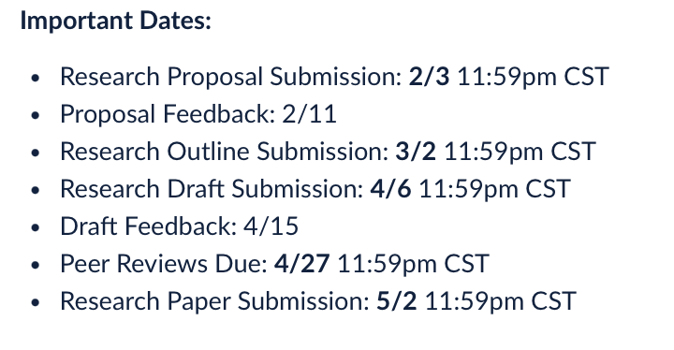
Research Proposal & Outline
Project feedback
Grade & feedback on Canvas (*almost complete - if you do not yet have a grade, it will show in the next 24hrs!)
Next step = Research Outline

Slide 24
Research Proposal & Outline
Project planning
Research Outline is the next deliverable on your project
Objectives:
Leverage LaTeX to begin a professional research document
Learn to integrate Bibtex for references
Explore research project management
Outline plans for effective research on your topic

Slide 25
Wrap-Up
Tuesday
Learn common tools for research in CS
Leverage tools to facilitate, organize, & guide your research
To Do:
Activity 3: Formulating Research Questions (in-class Thursday)
Quiz 1 (on Canvas)
Review your proposal feedback (on Canvas)
See you Thursday!

Slide 26
Activity 3:
Formulating Research Questions

Slide 27
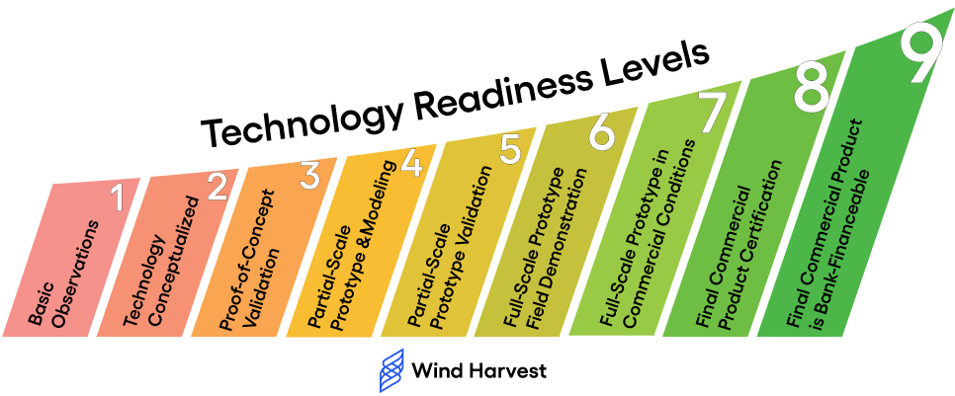
https://windharvest.com/blog/2022/07/29/technology-readiness-levels-the-path-to-commercialization/

Slide 28
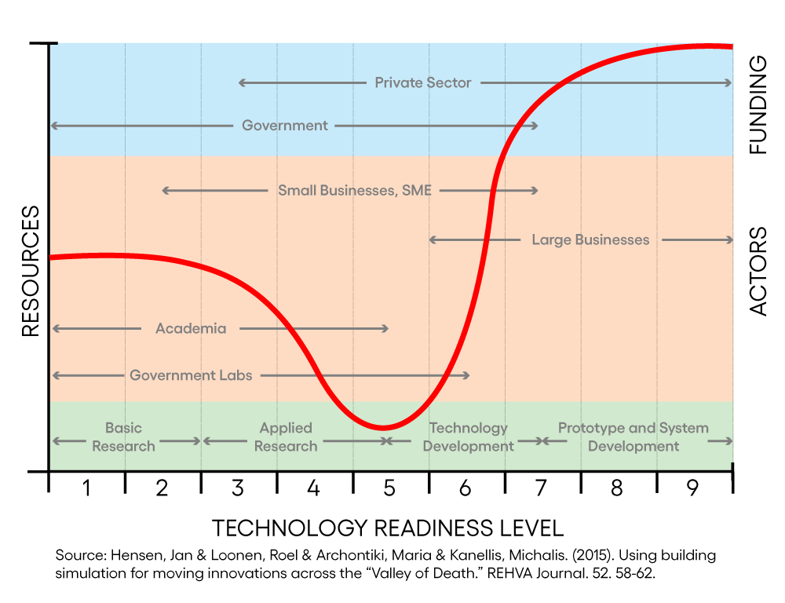
https://windharvest.com/blog/2022/07/29/technology-readiness-levels-the-path-to-commercialization/

Slide 29
Wrap-Up
Thursday
Leverage tools to facilitate, organize, & guide your research
Create a research plan for investigating real, relevant topics
To Do:
Activity 3: Formulating Research Questions (in-class Thursday)
Quiz 1 (on Canvas)
Review your proposal feedback (on Canvas)
See you next week!

